Slide 1
Project Presentation
Submitted By :- Amit Kumar (201500079)
Pratham Panjwani (201500511)
Saurav Kumar Singh (201500634)
Tushar Srivastava (201500747)

Slide 2
Things Around Us
E-commerce website​

Slide 3
AGENDA
Introduction​
Primary goals
​Areas of growth
Timeline
​Summary​

Slide 4
Introduction
The “ Things Around Us“ is e-commerce website strives to provide solutions to develop and transfer easy and efficient way in the digital age and to help reduces the human pressure and time.
E-commerce is fast gaining ground as an accepted and used business paradigm. . More and more business houses are implementing web sites providing functionality for performing commercial transactions over the web.

Slide 5
PRIMARY GOALS
To Provide Ease in shopping and selling.
We have created a basic structure of website so that anyone can use it.

Slide 6
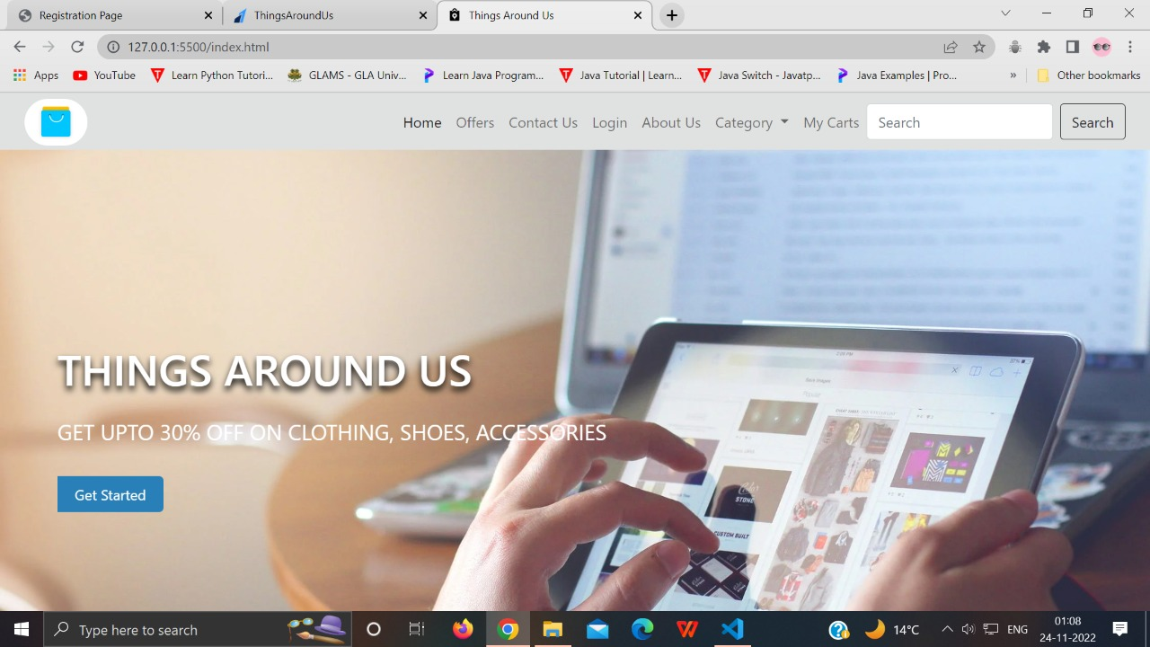
Home page

Slide 7
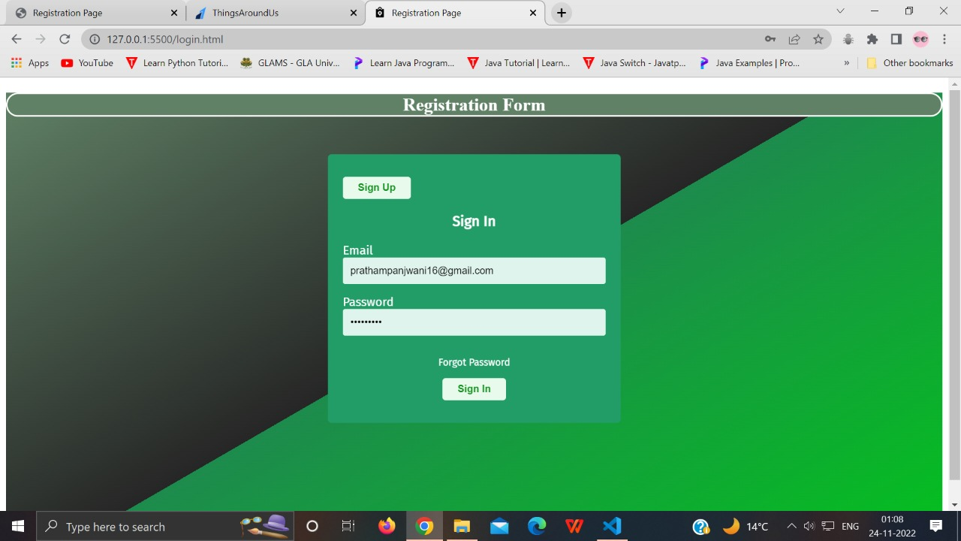
Login/Sign Up page
We have Created a creative sign up page with the help of Css (linear gradiant )
We have also linked it with database we face problems but eventually we did it.

Slide 8
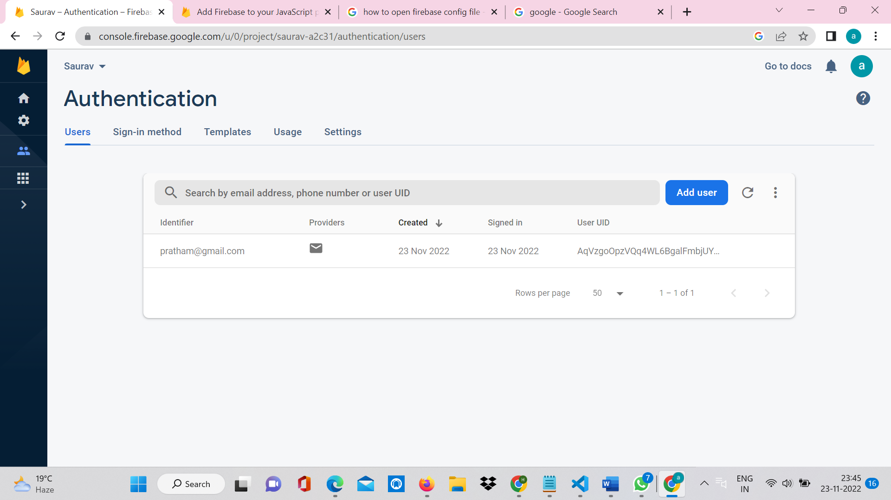
Database
We have linked it with Firebase
And the data has been stored there.
Email,passsword,etc
We can also restrict someone using
Our website.

Slide 9
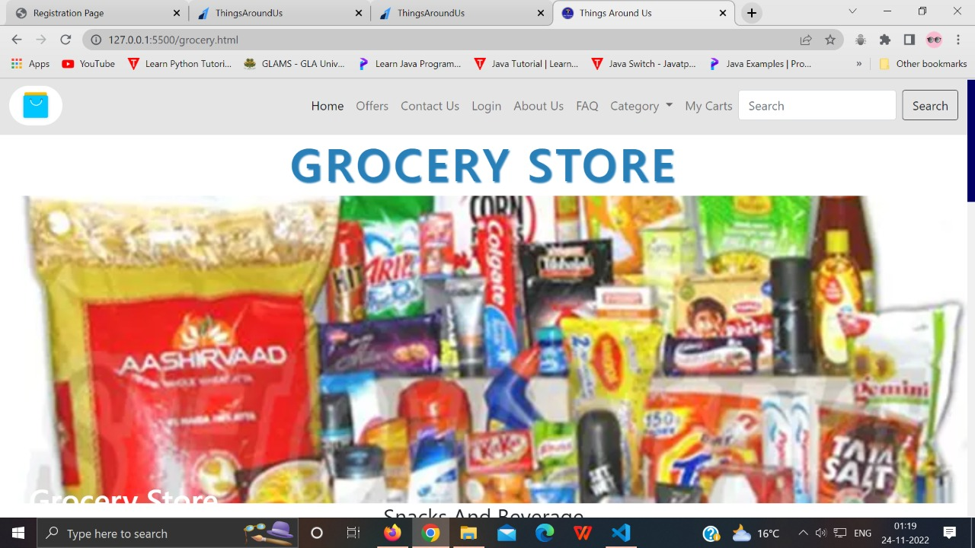
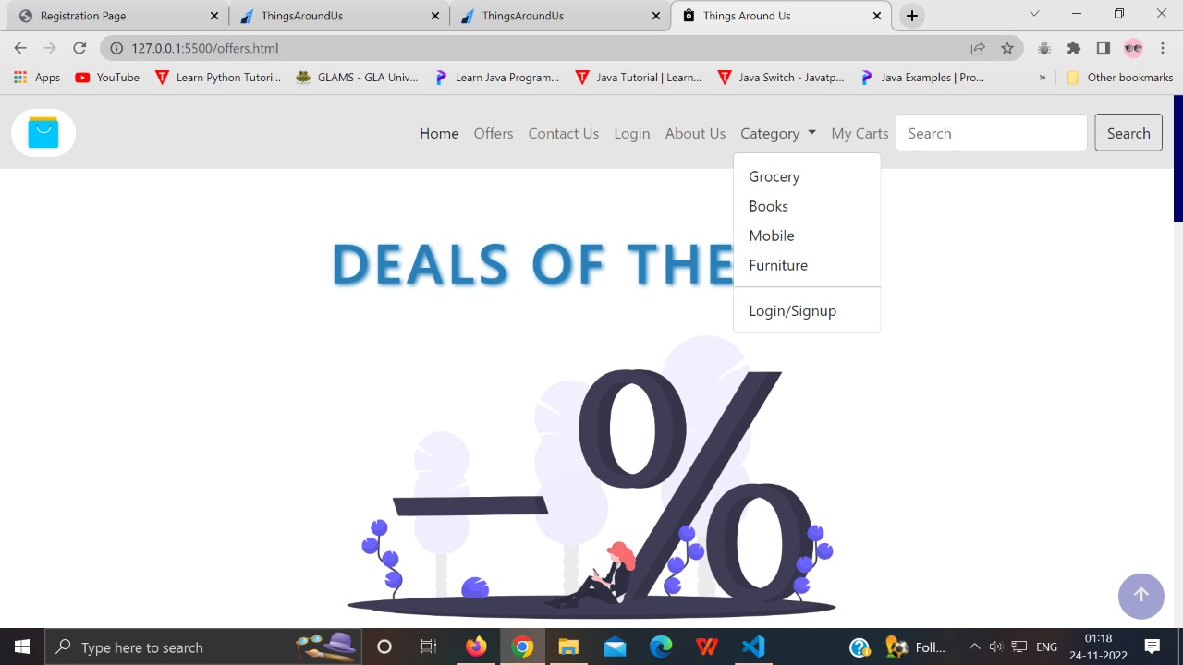
categorized selling pages
We have Created a categorized selling pages like grocery, books,furniture,etc.
when we move to those page we will get to know about various product listed on website
You would also get discount which you can see from offer page

Slide 10
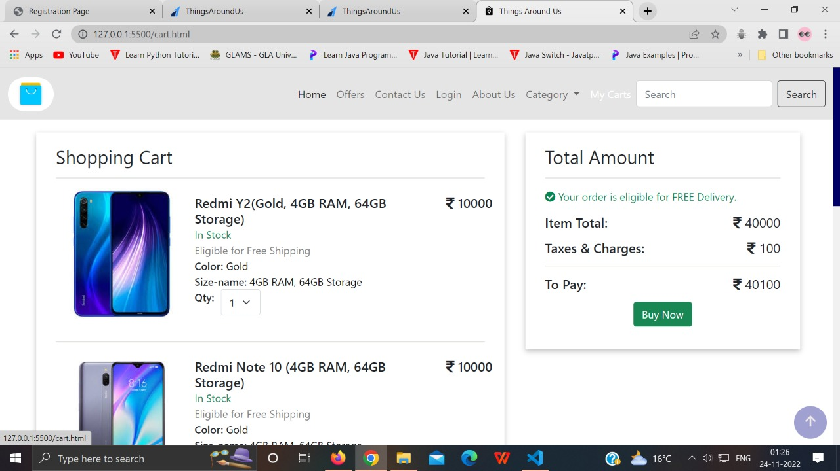
Cart Page
When you add things to your cart
It will redirected you to card page
Where add quantity of the product.
And when to click payment (buy Now)
It will redirected you to the payment page.

Slide 11
Payment Page
Payment page is redirected to razorpay and anyone can do payment if you want to verify.
And someof the product we also redirected to amazon affiliate link😊

Slide 12
BUSINESS OPPORTUNITIES ARE LIKE BUSES. THERE'S ALWAYS ANOTHER ONE COMING.
“
”
Richard Branson

Slide 13
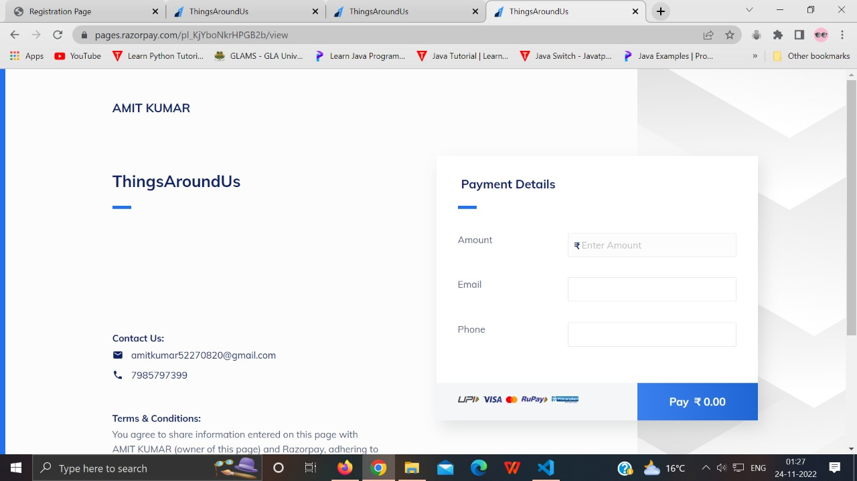
Payment page is redirected to razorpay and anyone can do payment if you want to verify.

Slide 14
SUMMARY
This project is only a humble venture to satisfy the needs in a shop. Several user friendly coding have also adopted. This package shall prove to be a powerful package in satisfying all the requirements of the organization. The objective of software planning is to provide a frame work that enables the manger to make reasonable estimates made within a limited time frame at the beginning of the software project and should be updated regularly as the project progresses.

Slide 15
THANK YOU

